Slide 1
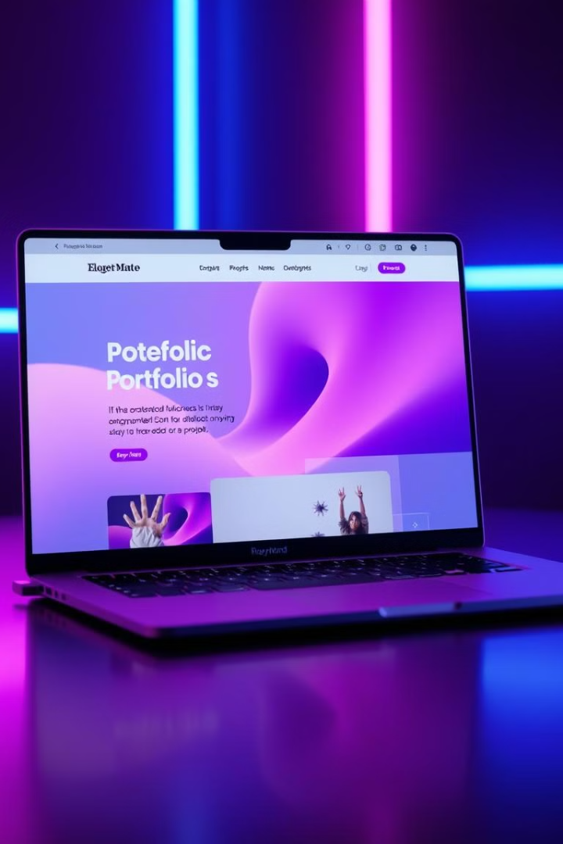
Final Project
Tanver Hossain Tonmoy Portfolio
The purpose of this lab is to analyze and evaluate the design and content presented on Tanvir Hossain Tonmoy's portfolio website, which highlights his skills and work as a graphics designer. The portfolio introduces Tanvir Hossain Tonmoy as a passionate and creative professional specializing in web design, graphic design, and video editing. The homepage prominently displays his name, role, and a brief introduction of his expertise. The use of a professional headshot alongside clear, concise text makes a strong first impression.

Slide 2
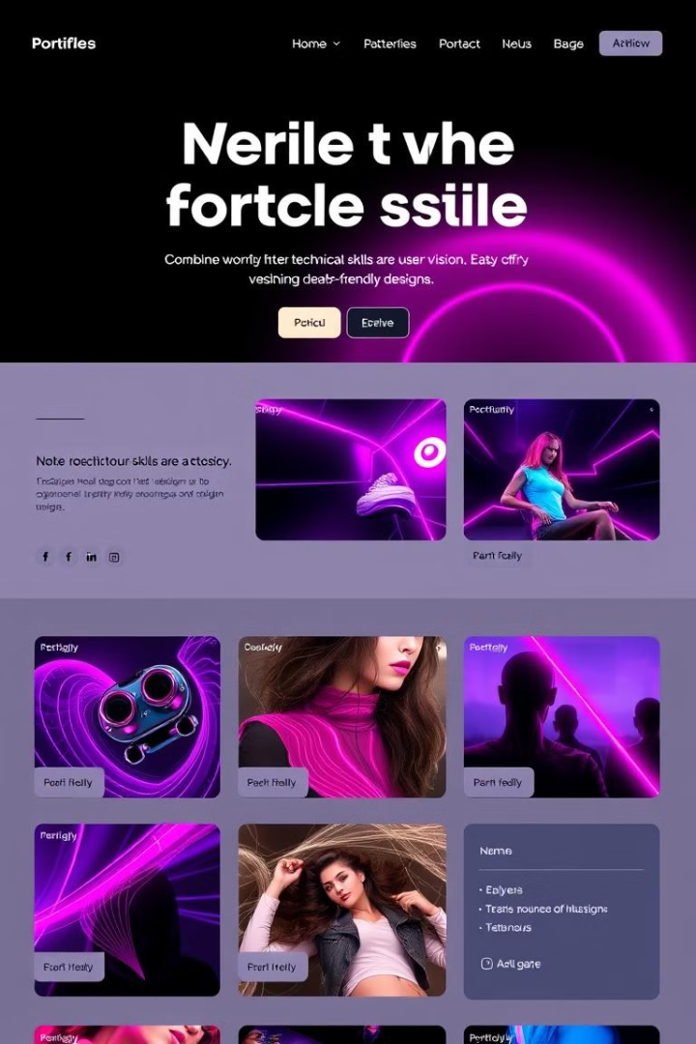
Content
The portfolio's introduction highlights the designer's approach to combining technical skills with artistic vision, ensuring both visually appealing and user-friendly designs. The text emphasizes his problem-solving abilities and his dedication to exceeding client expectations.

Slide 3
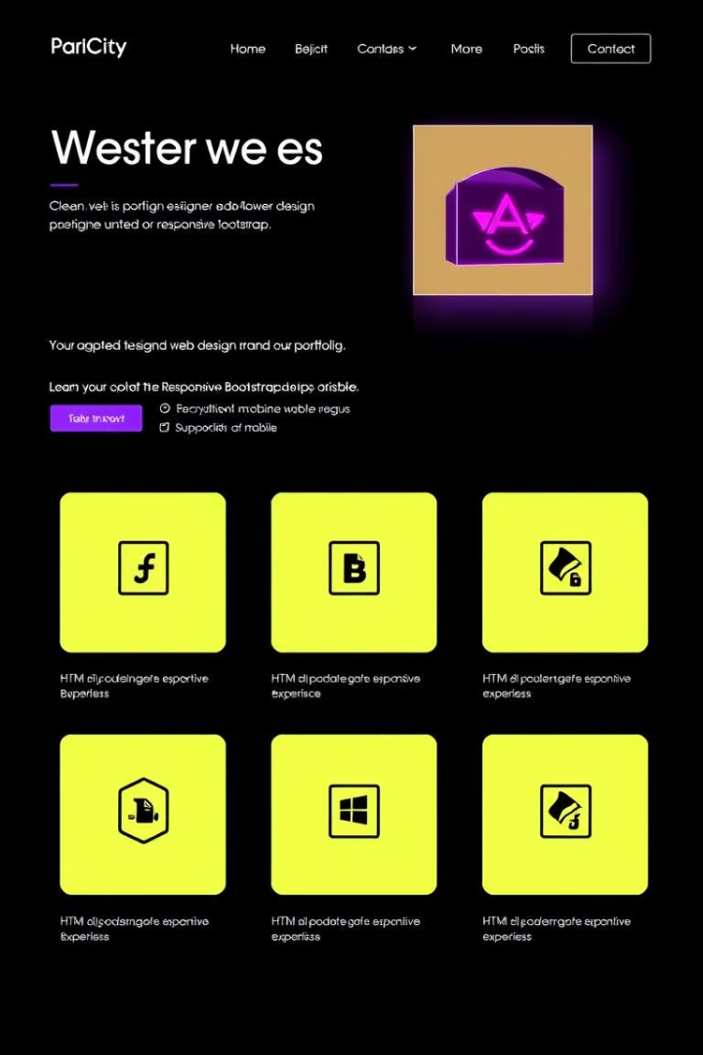
Web Design Service
1
User-Friendly & Responsive
The portfolio offers web design services focusing on creating user-friendly and responsive websites. The designer emphasizes crafting websites with HTML, CSS, and Bootstrap, ensuring mobile compatibility and ease of navigation.
2
Sample Projects & Testimonials
The service section can be enhanced by showcasing sample projects, testimonials, or case studies for better impact.

Slide 4
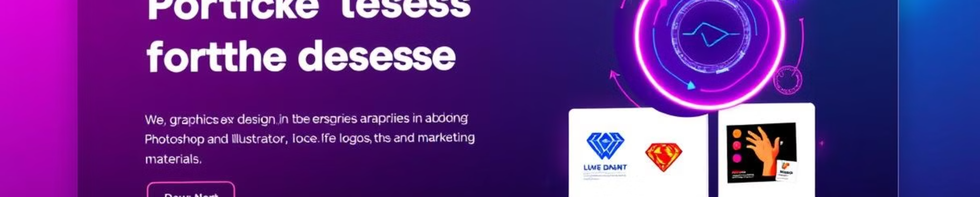
Graphics Design Service
Logo Design
Branding
The portfolio emphasizes proficiency in Adobe Photoshop and Illustrator for creating visually compelling designs. The graphics design service includes logo design, branding, and promotional materials.
The clean and modern design of the portfolio itself is an example of the designer's ability to create aesthetic visual experiences.

Slide 5
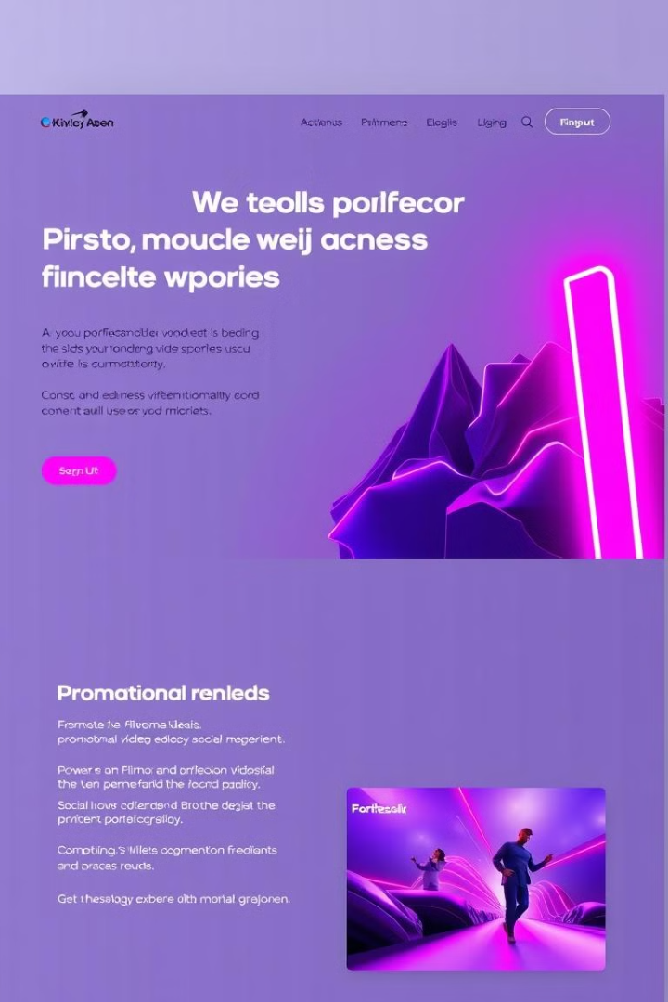


Video Editing Service
Filmora Expertise
With experience in using Filmora, the portfolio highlights the designer's video editing services. This includes basic to intermediate-level video editing for promotional videos, social media content, and personal projects.
Demo Reels & Sample Videos
The addition of short demo reels or sample videos would further strengthen this section.

Slide 6
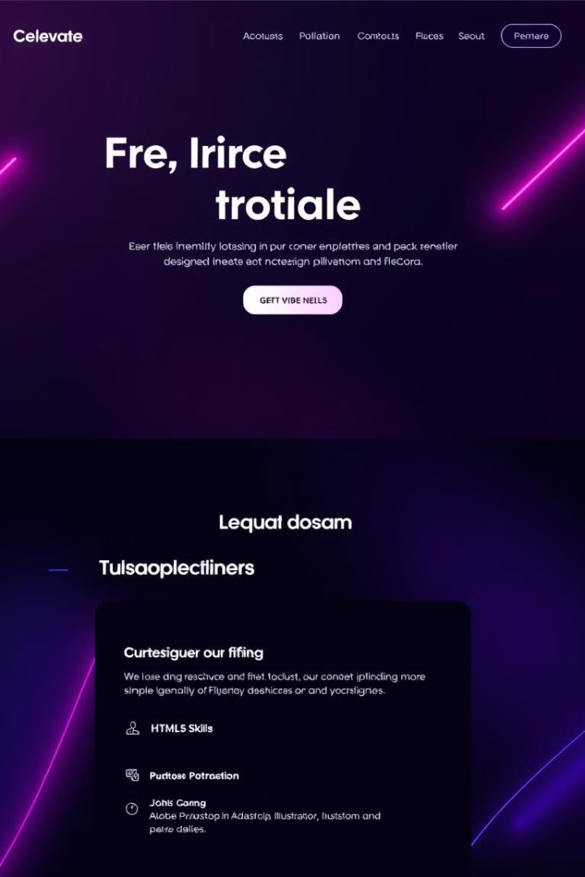
Technical Skills
HTML & CSS
Proficient in structuring and styling websites, ensuring responsive and accessible designs.
Bootstrap
Ability to use this framework to create flexible and mobile-first designs.
Basic JavaScript
Provides interactive elements for websites, enhancing the user experience.

Slide 7
Backend Services
1
User Accounts Authentication
A user can register his/her account with a safety encrypt password by hashing method in backend, And also user can login by email and password
2
Project Services CRUD Operations
Here is four service in backend , admin or manager can create a project which is can show her frontend as Project
3
Feedbacks Services Operations provided
Here is have a feedback system, when a client happy to work with me , She/ He can write a review of my best.

Slide 8
Design Elements
Color Scheme
Typography
Layout
The portfolio features a dark background with minimal star-like patterns, giving it a sleek, modern look. The use of contrasting colors, such as white and red, helps highlight key information, making the design both elegant and eye-catching.
The text is easy to read with clear hierarchy. The name and role ("Tanvir Hossain Tonmoy" and "Graphics Designer") are highlighted in larger, bold fonts, drawing attention to the most important details.
The layout is straightforward and user-friendly, with navigation links at the top for Home, Skillset, Projects, Resume, and Contact Me. This provides easy access to different sections of the portfolio.

Slide 9
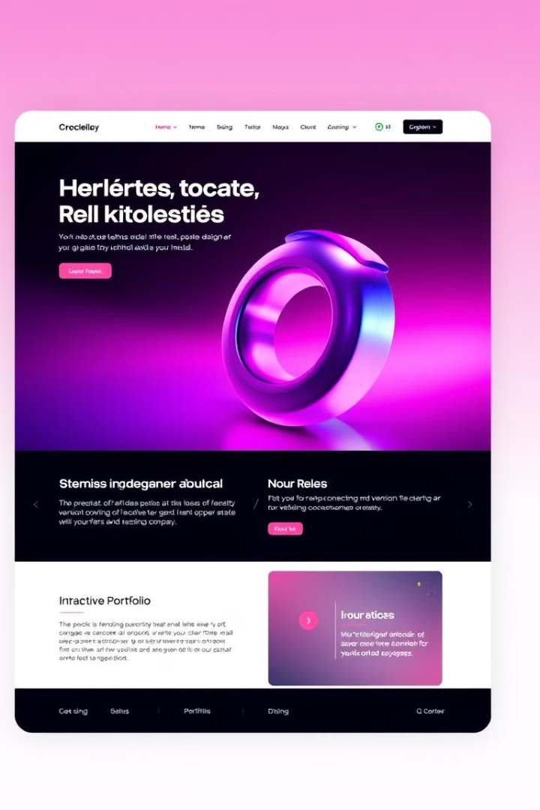
Conclusion
The service section and the wide range of skills listed in the portfolio provide a clear and professional overview of the designer's capabilities. Highlighting diverse expertise in web design, graphic design, and video editing, the portfolio demonstrates a blend of both technical and creative proficiencies. Including more portfolio examples or client testimonials would enhance the credibility and impact of these services.

